Slide 1
Academic Bank of Credits(ABC)
19 April 2023

Slide 2

Agenda
Objective
Notifications and Circulars
NAD/ABC Statistics
Registration Process for AI
Student Flow

Slide 3
Objective
The Hon’ble Prime Minister launched the project on 29th July 2021(1st Anniversary of NEP 2020)
ABC Benefits
Portal Features
credit recognition, credit accumulation, credit transfers,
Upload credits digitally and maintains the integrity of the credits
Multiple Entry/Exit
Single sign-on through Meri Pehchaan
Student Mobility
Multiple channels for Registration
Distributed and flexible teaching-learning
Unified platform for NAD & ABC
Maintain the authenticity, integrity, and confidentiality
Integrated with API Setu for real time verification

Slide 4
Notifications & Circulars from UGC
UGC
notification reg Implementation of ABC for credits mobility
UGC
notification reg Acceptance of documents through DigiLocker
ABC concept is proposed by NEP 2020
1st amendment : All HEIs are allow to participate
UGC
request all HEIs to join ABC
UGC
notification reg Implementation of ABC
UGC
issue ABC Regulation with the concurrence of MoE
29.07.20
29.07.21
28.12.21
12.01.22
03.01.22
13.05.22
22.09.22

Slide 5
NAD/ABC DigiLocker Statistics
NAD Registration Status
ABC Registration Status
Central Universities
Private Universities
Academic Institutions Registered
Institutions of National Importance
Deemed Universities
State Universities
Other Academic Institutions including Boards
Central Universities
Private Universities
Academic Institutions Registered
Institutions of National Importance
Deemed Universities
State Universities
Other Academic Institutions including Boards
1689
686
130
80
33.34+ Lacs ABC ID Created
53
53
389
186
337
207
120
85
660
75

Slide 6
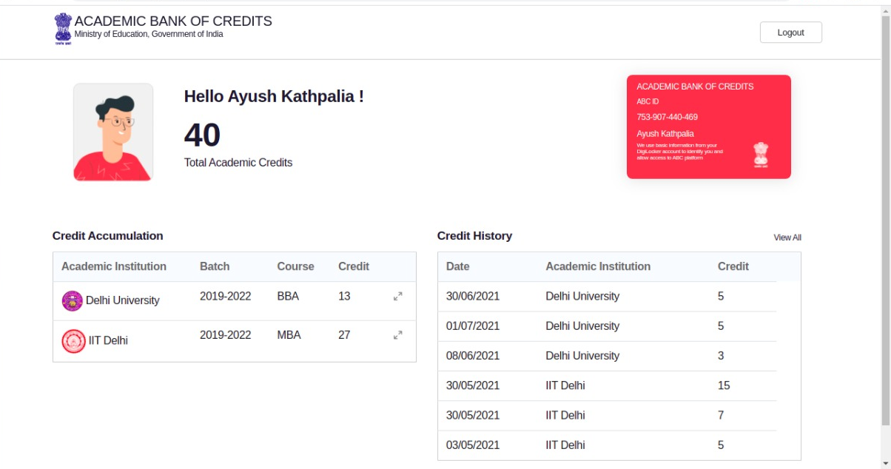
ABC Registration Process
for
Academic Institution

Slide 7
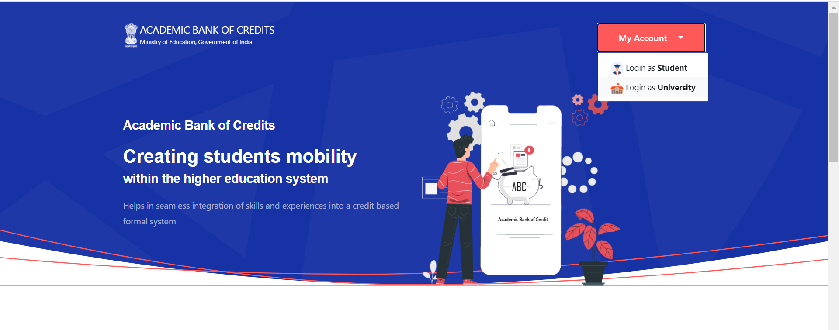
Landing Page
Institutions that are not registered under NAD, needs to register themselves using existing NAD flow
www.abc.gov.in

Slide 8
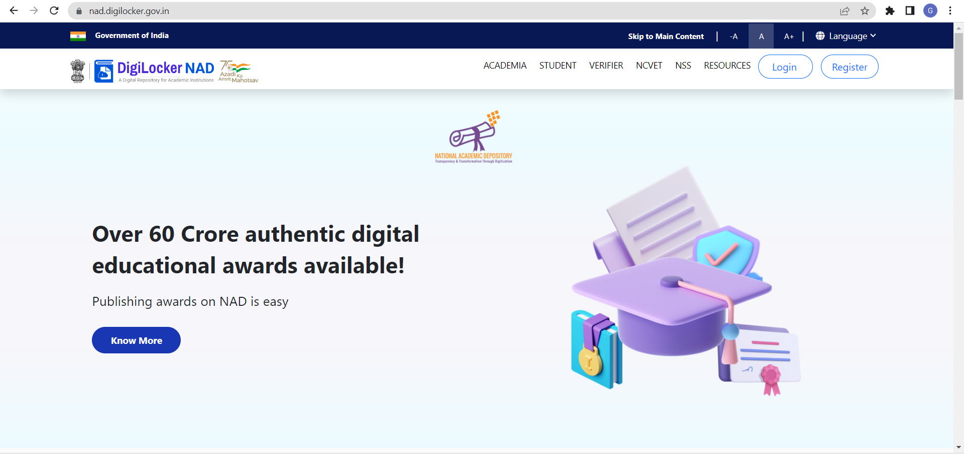
DigiLocker- NAD
Existing AI to click on Login
New AI to click on Register
www.nad.digilocker.gov.in

Slide 9
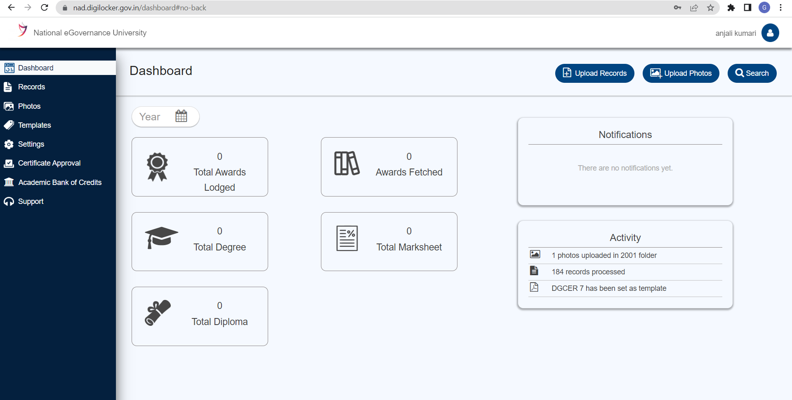
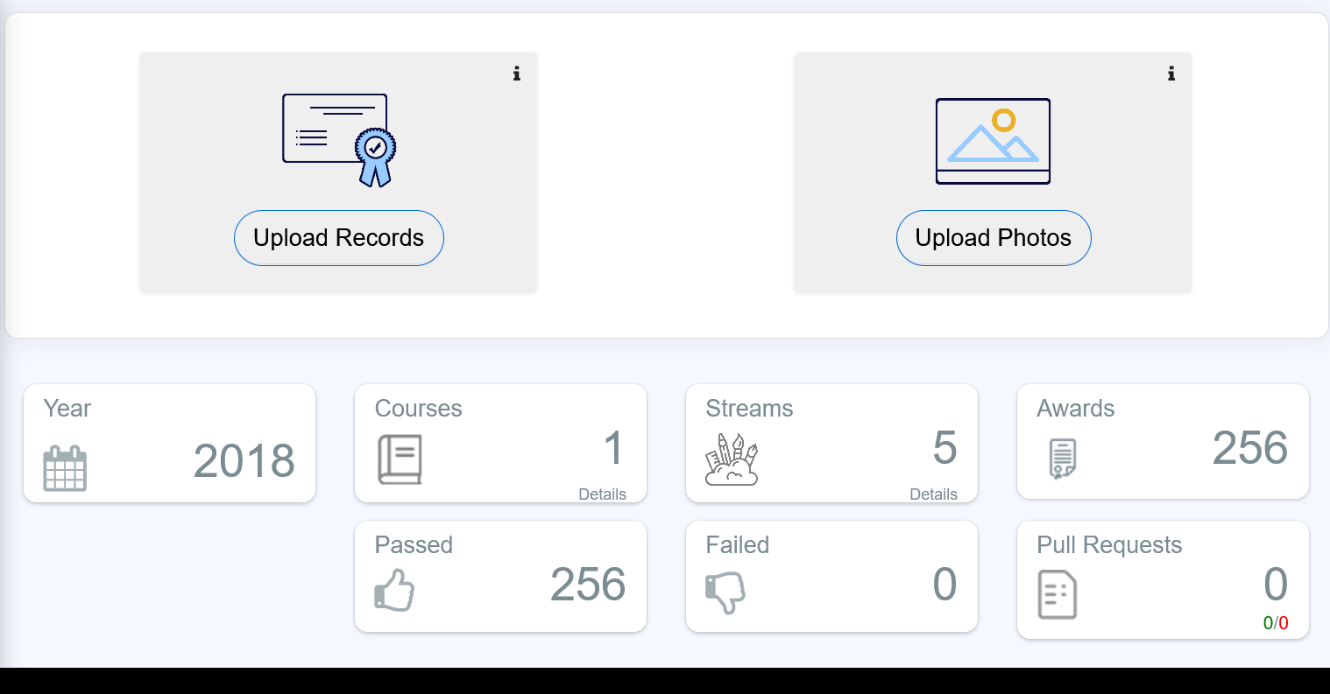
Dashboard
AI need to click here to register/check status
**Only NAD approved AI can join ABC

Slide 10
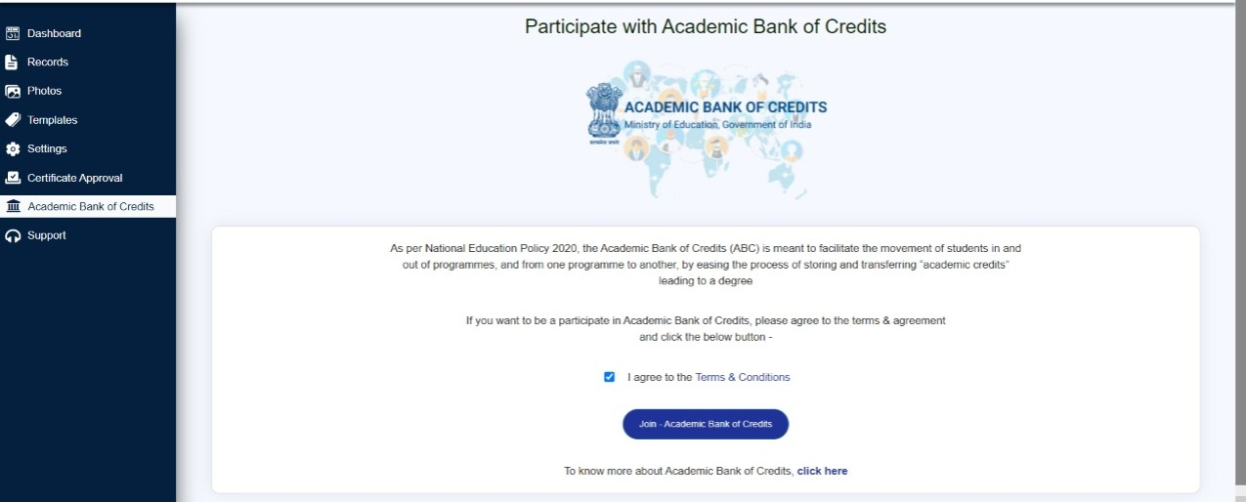
ABC Console
AI need to click here to register/check status
Click here to join ABC

Slide 11
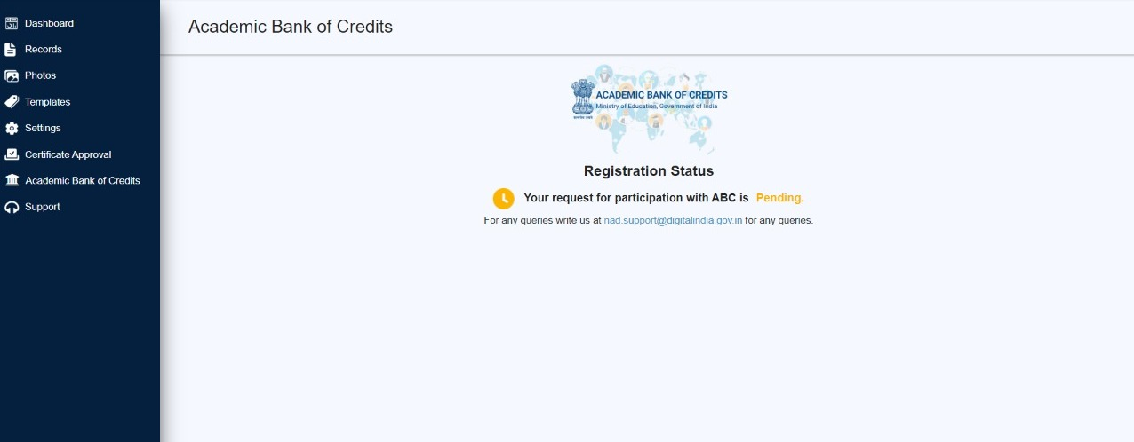
ABC Console
**AI gets approved within 72 working hours post registration

Slide 12
Student Flow- ABC

Slide 13
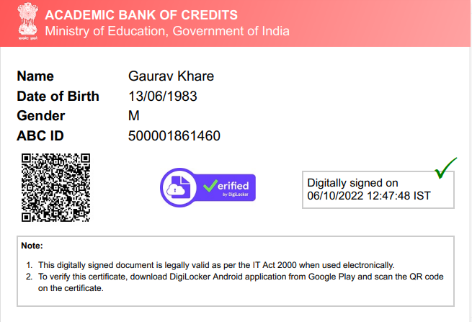
ABC ID Card
Multiple Sources for generating ABC ID
ABC ID
DigiLocker
ABC Portal
Umang
Coming Soon

Slide 14
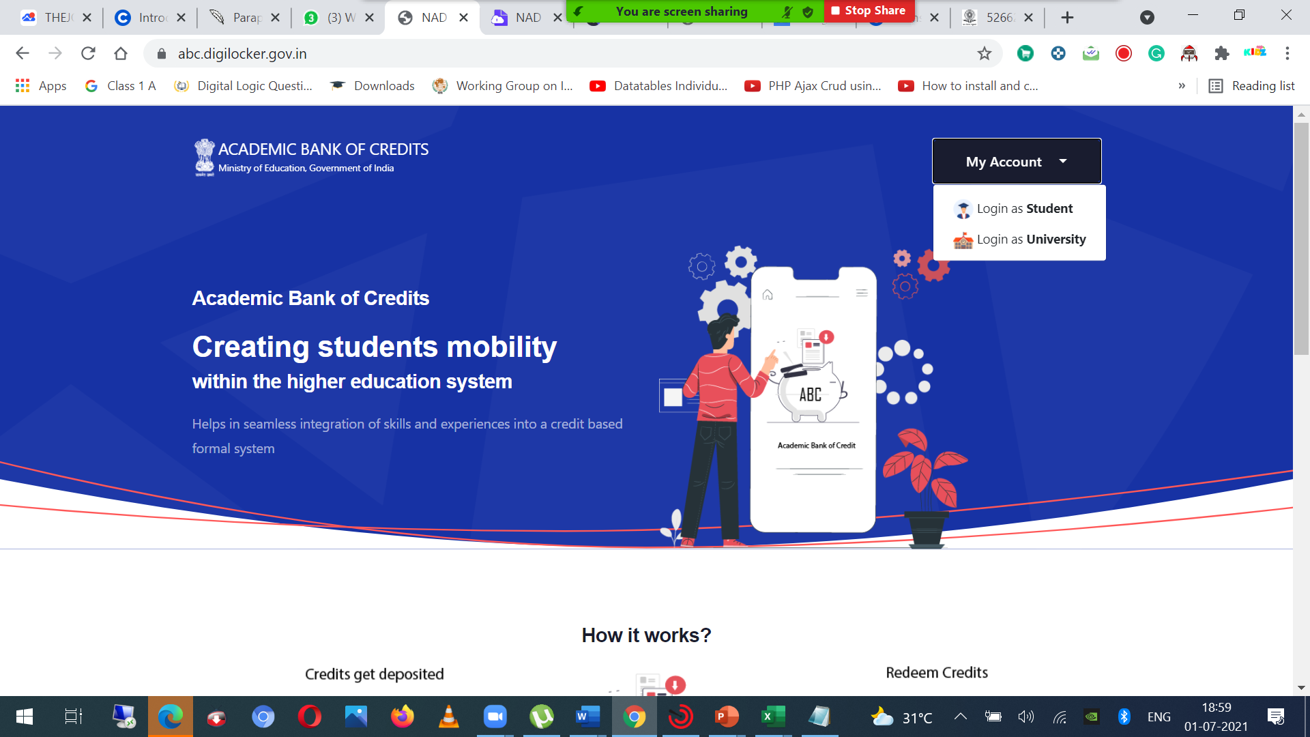
Landing Page - https://www.abc.gov.in/

Slide 15
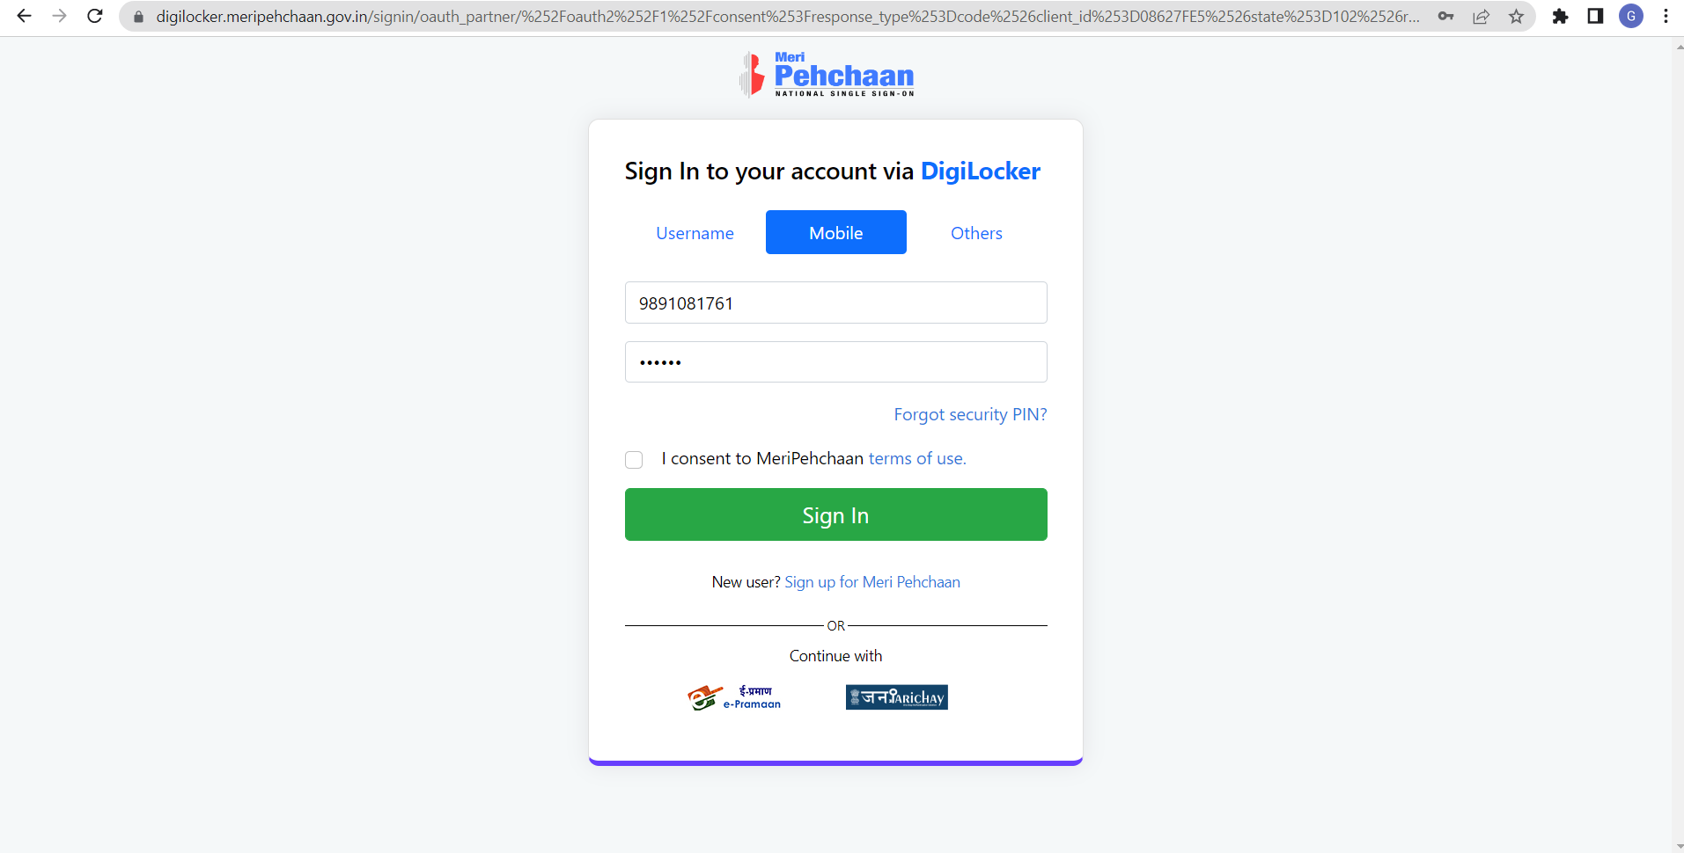
Single sign-on with Meri Pehchaan

Slide 16
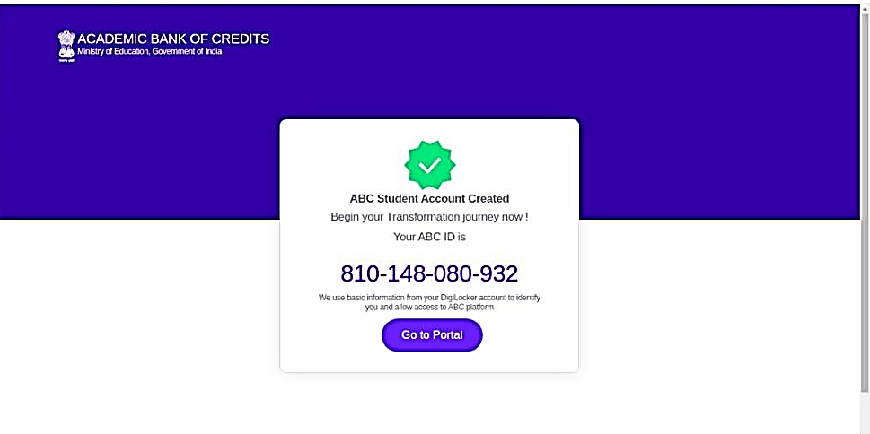
ABC Student Account

Slide 17
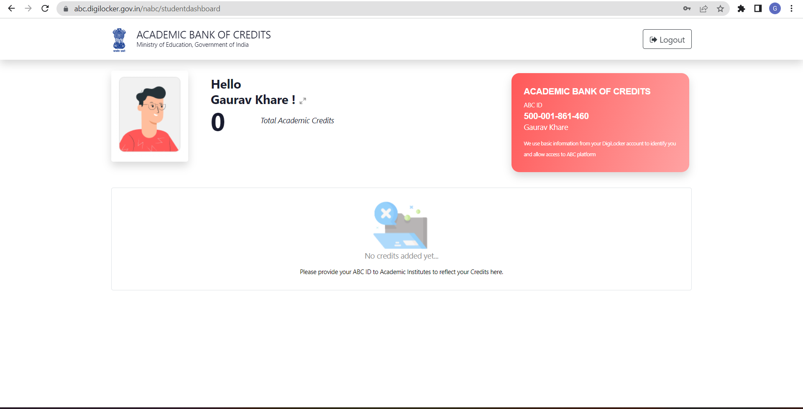
Student Dashboard

Slide 18







How ABC Works
Student Creates
ABC ID
Student Shares
ABC ID with AI
AI captures ABC ID
AI Prepares the input file along with ABC ID
In the NAD format
Credits Earned will reflect in the student ABC account
AI Uploads the CSV file on NAD Portal

Slide 19
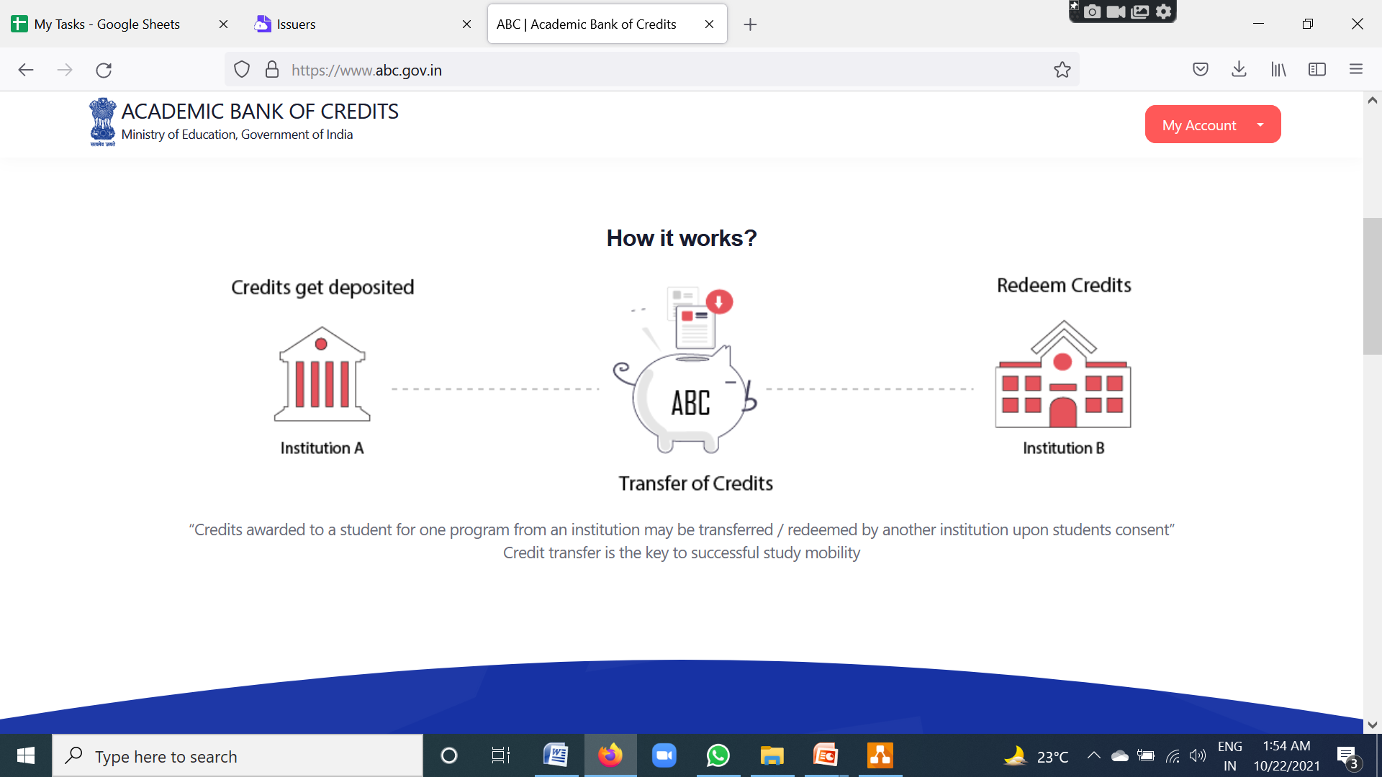
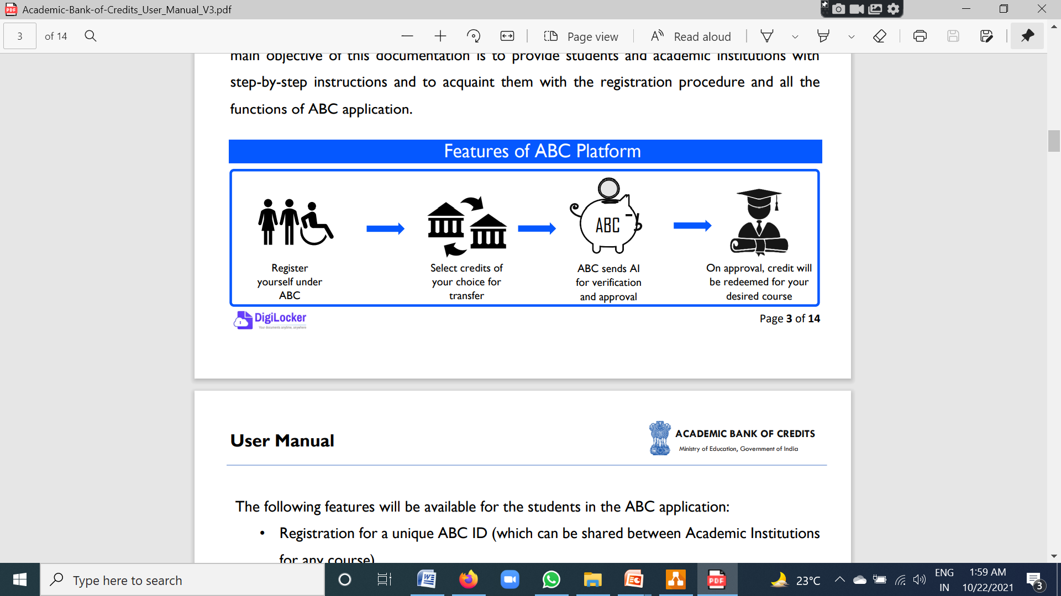
How ABC Works

Slide 20
Resources
https://abc.gov.in/resources.php
ABC ID User Manual
Instructional Template for Facilitating Implementation of Choice Based Credit System (CBCS)
Guidelines for Preparing Marksheet/Transcript CSV
Marksheet /Transcript Sample CSV for Universities

Slide 21

Thank you.
support@nad.digitallocker.gov.in
gaurav.khare1@digitalindia.gov.in
9891081761

